Slide 1





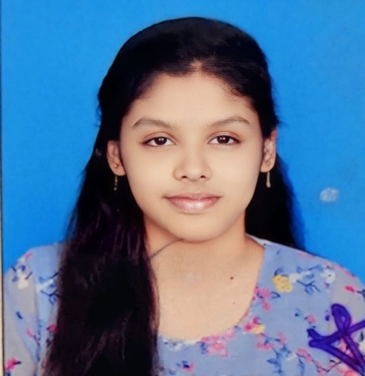
DEPARTMENT OF computer SCIENCE AND ENGINEERING(AI&ML)
Industrial Oriented Mini Project
ON
ADAPTIVE IMAGE ENHANCEMENT TECHNIQUES FOR SUPERIOR VISUAL QUALITY IN
PHOTOGRAPHIC AND SURVEILLANCE APPLICATIONS
PRESENTED BY
M. HARSHA REDDY
(22RA1A6628)
B. ARAVIND REDDY (22RA1A6610)
S. CHANDRASHEKAR (22RA1A6618)
D.DISHA (22RA1A6623)
UNDER THE GUIDANCE OF
Mrs. G. SUJATHA
ASSISTANT PROFESSOR, M-TECH(Ph.D)

Slide 2

ABSTRACT
Image enhancement is essential in digital image processing for improving visual quality in fields like photography and surveillance. Traditional filtering methods often fail to preserve details and adapt to complex lighting conditions. This study proposes an Adaptive Histogram Equalization (AHE) technique that divides images into local tiles for contrast enhancement while using a contrast-limiting parameter to reduce noise amplification. Evaluated using PSNR, MSE, and SSIM, the method shows significant improvement in image clarity and structure. AHE proves effective for real-time applications requiring high-quality visuals in diverse environments.
ADAPTIVE IMAGE ENCHANCEMENT TECHNIQUES FOR SUPERIOR VISUAL QUALITY IN PHOTOGRAPHIC AND SURVEILLANCE APPLICATIONS

Slide 3

EXISTING SYSTEM
Median Filter-Based Enhancement uses a Median Filter for image enhancement. It works by replacing each pixel value with the median of its neighborhood pixels
Key Steps:
Image Preprocessing: Convert to grayscale, resize, and detect noise type.
Window Size Selection: Choose a kernel (e.g., 3×3 or 5×5) based on noise level.
Median Replacement: Replace center pixel with the median of surrounding pixels.
Image Reconstruction: Rebuild the image with reduced noise while preserving edges.
Quality Assessment: Evaluate output using PSNR, SSIM, and MSE metrics.
DISADVANTAGE-1
Loss of Fine Texture Details:
Median filtering may remove small but important image textures and patterns, leading to excessive smoothing.
:
DISADVANTAGE-2
Edge Distortion with Large Window Sizes:
Larger filter kernels can blur or distort edges and boundaries, reducing image clarity.
:

Slide 4

Hybrid Adaptive Histogram Equalization (HAHE) system enhances image contrast by applying adaptive histogram equalization on local regions while preserving color and reducing noise.
Key Steps:
Color Space Conversion: Convert RGB image to YCrCb and enhance only the luminance (Y) channel.
Block-wise CLAHE: Divide Y channel into blocks and apply CLAHE with adaptive clip limits based on local contrast.
Reconstruction: Merge enhanced Y with original Cr and Cb channels, convert back to RGB.
Quality Evaluation: Assess output using PSNR and SSIM for detail preservation and clarity.
PROPOSED
SYSTEM
ADVANTAGE-1
Improved Local Contrast with Detail Preservation: Enhances both dark and bright regions adaptively while retaining fine textures and natural image structure.
:
ADVANTAGE-2
Noise Control through Adaptive Clip Limiting: Dynamically adjusts enhancement strength to prevent over-amplification and suppress noise effectively.

Slide 5

SYSTEM REQUIREMENTS
SOFTWARE
HARDWARE
Python 3.7.6
TensorFlow Environment
PACKAGES
Keras
Numpy
Pandas
Scikit
Matplotlib
seaborn
Intel(R) Core(TM) i5-8350U CPU @ 1.70GHz 1.90 GHz
256 MB of RAM
64-bit systems, Windows 11

Slide 6
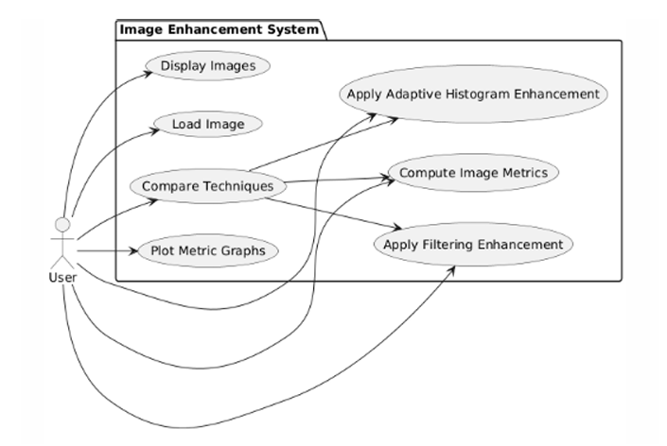



UML DIAGRAM
USE CASE DIAGRAM

Slide 7
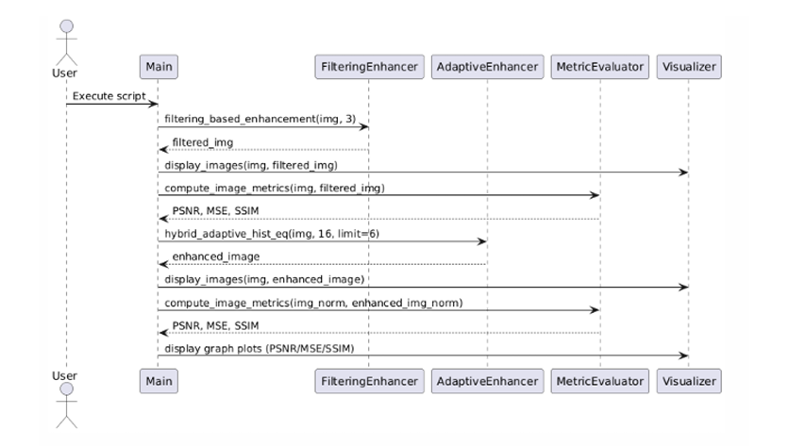
UML DIAGRAM
SEQUENCE DIAGRAM

Slide 8
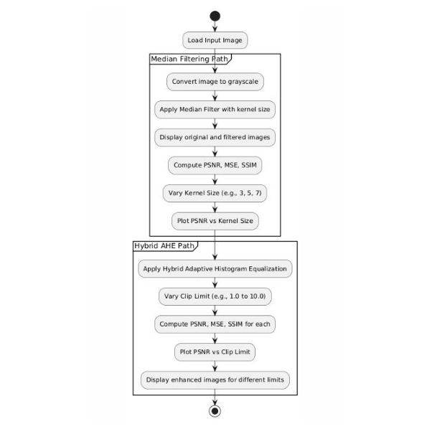

ACTIVITY DIAGRAM
Exploring creativity

Slide 9


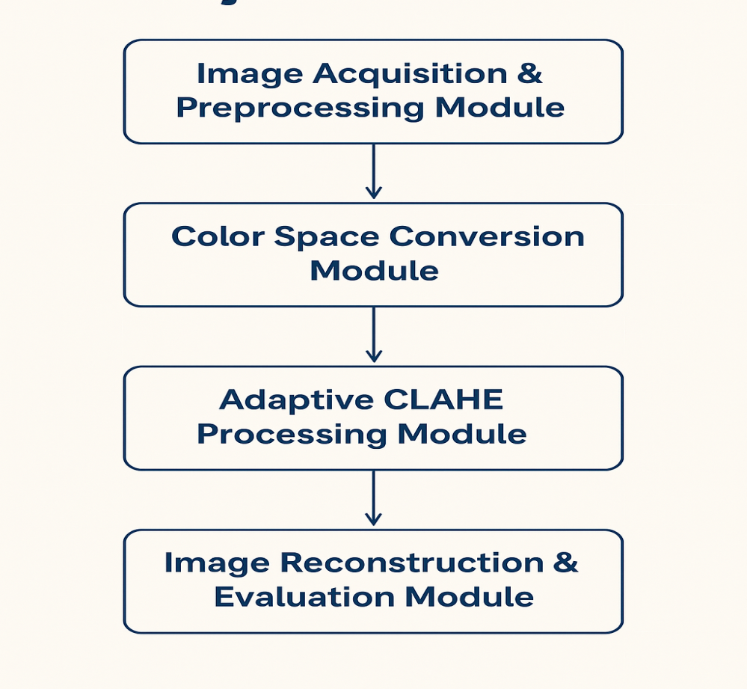

MODULES
1. Image Acquisition & Preprocessing Module
2. Colour Space Conversion Module
3. Adaptive CLAHE Processing Module
4. Image Reconstruction & Evaluation Module
Exploring creativity

Slide 10
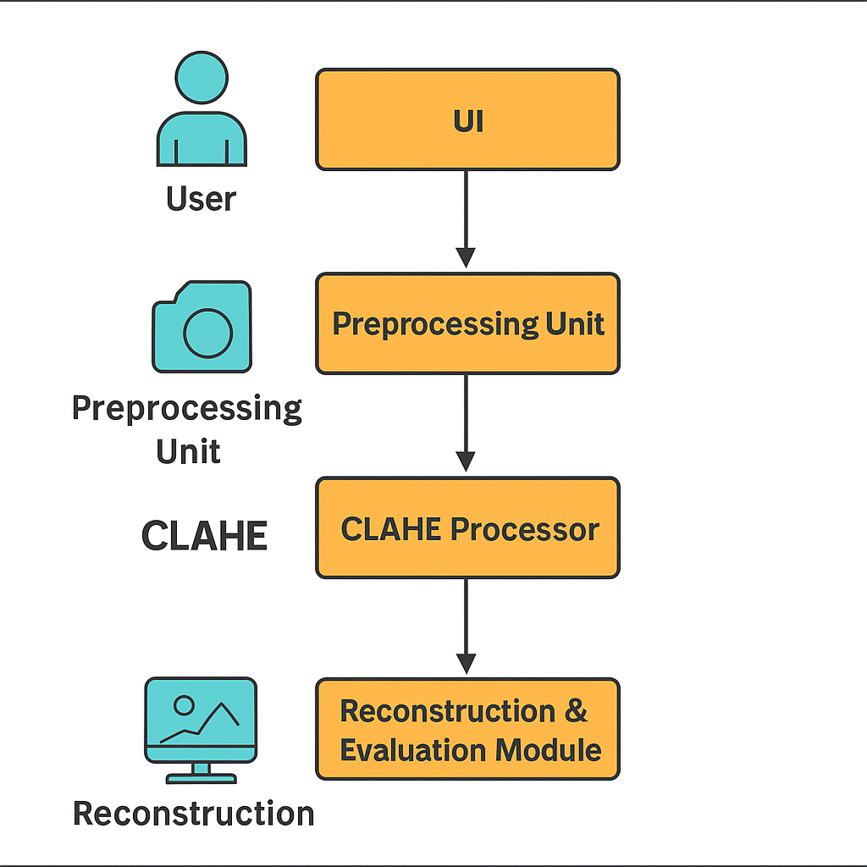
MAIN ROLES
SYSTEM ARCHITECTURE
1. User Interface (UI):
2. Preprocessing Unit:
3. Image Enhancement Engine (CLAHE Processor):
4. Reconstruction & Evaluation Module:

Slide 11
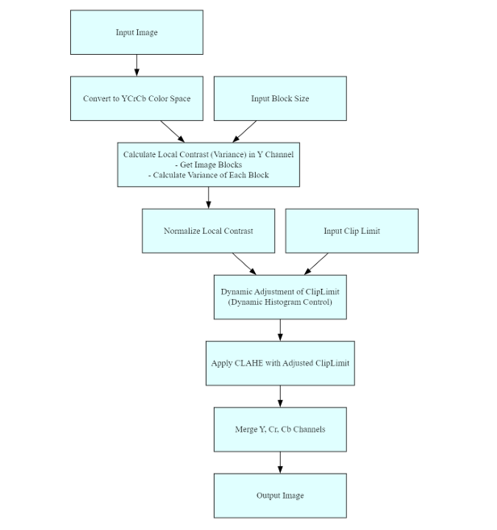
CLAHE [Proposed system]
ALGORITHM
Convert RGB image to YCrCb color space.
Extract the Y (luminance) channel.
Divide Y into small tiles (e.g., 8×8).
Compute & Clip Histogram of each tile using a clip limit.
Redistribute clipped pixels evenly across bins.
Equalize each tile using the adjusted histogram
Apply Bilinear Interpolation to smooth transitions
Merge enhanced Y with Cr and Cb, then convert back to RGB.

Slide 12
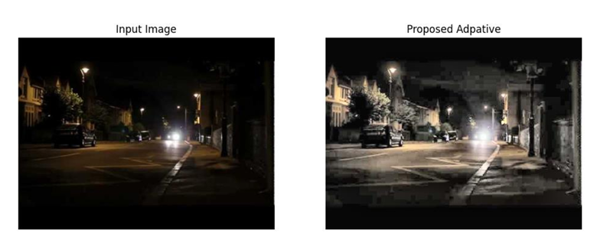
ENHANCED OUTPUT

Slide 13

CONCLUSION
The proposed Hybrid Adaptive Histogram Equalization (HAHE) method enhances image contrast intelligently by adapting to local variations in brightness. Unlike traditional techniques, it effectively balances contrast improvement with detail preservation and minimal noise amplification. This approach ensures high-quality visual output, making it well-suited for real-world applications like medical imaging, surveillance, and low-light enhancement.
ADAPTIVE IMAGE ENCHANCEMENT TECHNIQUES FOR SUPERIOR VISUAL QUALITY IN PHOTOGRAPHIC AND SURVEILLANCE APPLICATIONS

Slide 14
FUTURE SCOPE
Real-time Implementation: Integrate the algorithm into real-time systems for surveillance cameras or mobile devices.
Deep Learning Integration: Combine HAHE with neural networks to further enhance feature extraction in complex images.
Multi-Channel Enhancement: Extend contrast enhancement to chrominance channels (Cr, Cb) for better color balance in low-light images.
Medical Imaging Optimization: Customize the approach for specific domains like X-rays, MRIs, and CT scans to highlight diagnostic details.

Slide 15
REFERENCES
1. Demirel, H.; Ozcinar, C.; Anbarjafari, G. Satellite image contrast enhancement using discrete wavelet transform and singular value decomposition. IEEE Geosci. Remote Sens. Lett. 2010, 7, 333–337.
2. Gonzalez, R.C.; Woods, R.E. Digital Image Processing, 3rd ed.; Prentice-Hall: Upper Saddle River, NJ, USA, 2006.
3. Ibrahim, H.; Kong, N.S.P. Brightness preserving dynamic histogram equalization for image contrast enhancement. IEEE Trans. Consum. Electron. 2007, 53, 1752–1758.
4. Arici, T.; Dikbas, S.; Altunbasak, Y. A histogram modification frame work and its application for image contrast enhancement. IEEE Trans. Image Process. 2009, 18, 1921–1935
5. Huang, S.C.; Cheng, F.C.; Chiu, Y.S. Efficient contrast enhancement using adaptive gamma correction with weighting distribution. IEEE Trans. Image Process. 2013, 22, 1032–1041.
6. Celik, T. Two-dimensional histogram equalization and contrast enhancement. Pattern Recog. 2012, 45, 3810–3824.

Slide 16


Slide 17


